Slide 1
Step 19 - Install git, Jenkin, Docker in EC2 instance

Slide 2
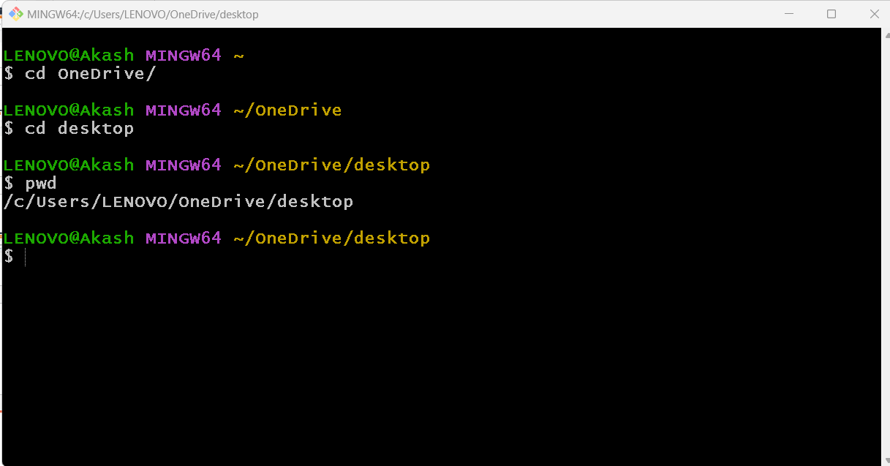
My file present in desktop so I have point to desktop using gitbash

Slide 3
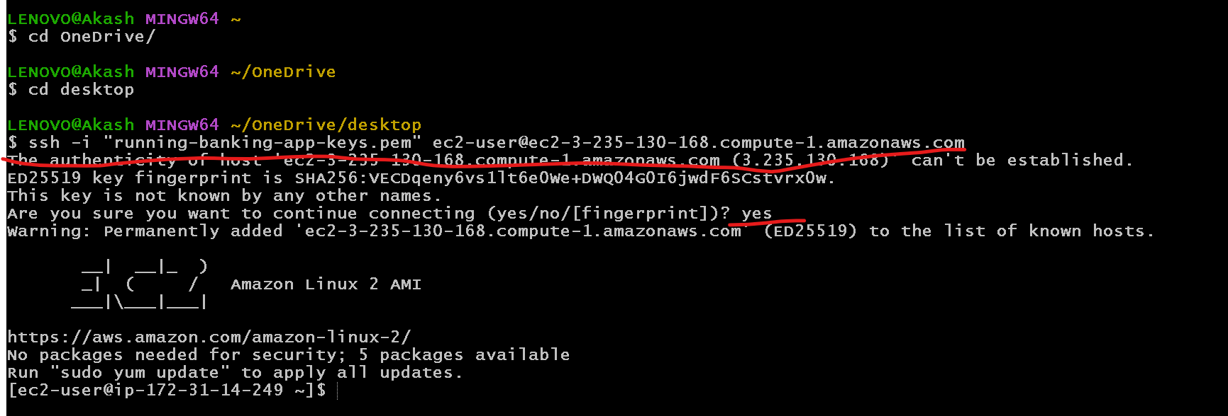
Please paste that command to connect this terminal to aws instance

Slide 4
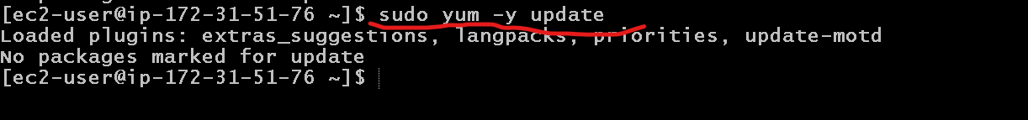
We need to update instance using command as
sudo yum –y update

Slide 5
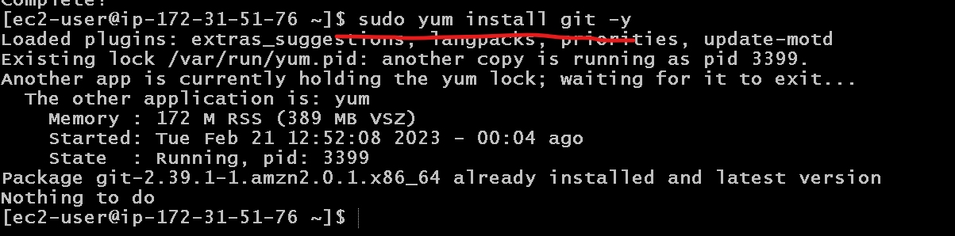
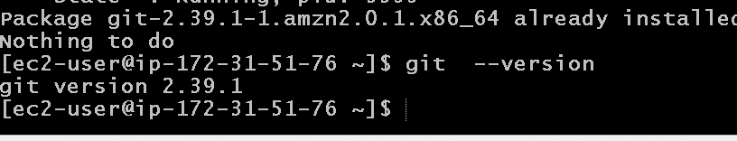
Now we need to instance git in ec2 instance
sudo yum install git –y

Slide 6
Now we will install the docker in EC2 instance
This command is use to install the docker
sudo yum -y install docker
This command is use to start the docker
sudo service docker start
This command is use to verify docker details
sudo docker info
This command is use to verify docker version and docker images
sudo doker –version
sudo docker images

Slide 7
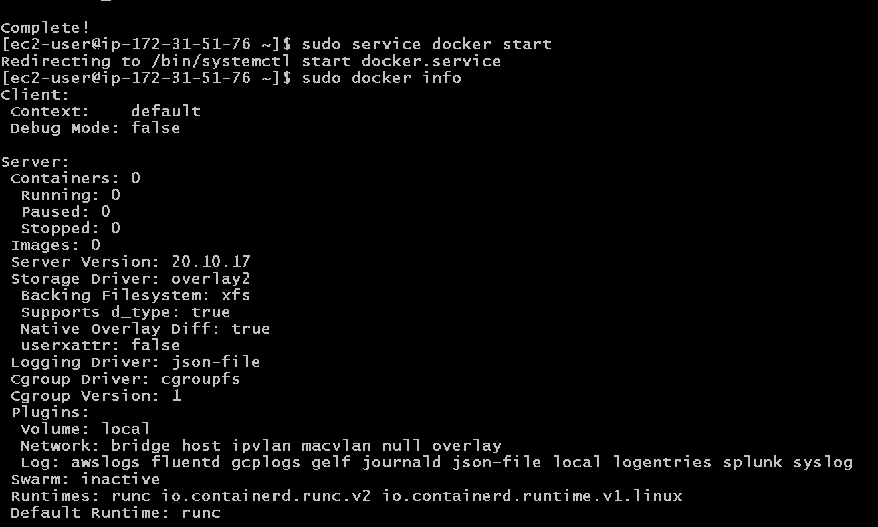

Slide 8
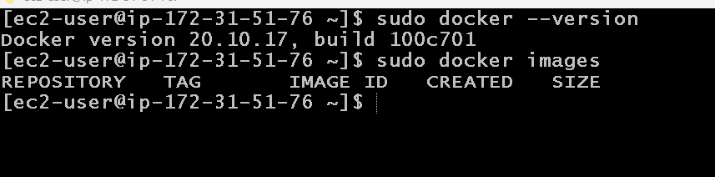

Slide 9
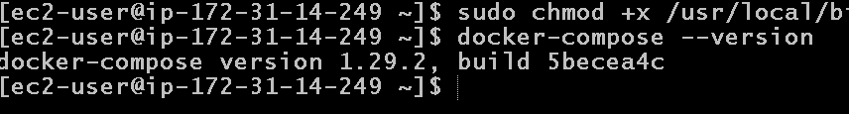
We need to install docker-compose
Because in EC2 instance by default docker-compose command not available
Below 2 command execute
sudo curl -L "https://github.com/docker/compose/releases/download/1.29.2/docker-compose-$(uname -s)-$(uname -m)" -o /usr/local/bin/docker-compose
sudo chmod +x /usr/local/bin/docker-compose

Slide 10
Now we will install Jenkin CI and CD tool in EC2 instance
Before Jenkin installation we need to install Java 11 because Jenkin is base upon the Java 11.
sudo amazon-linux-extras install java-openjdk11
It will ask you y/n :please enter y
java --version

Slide 11
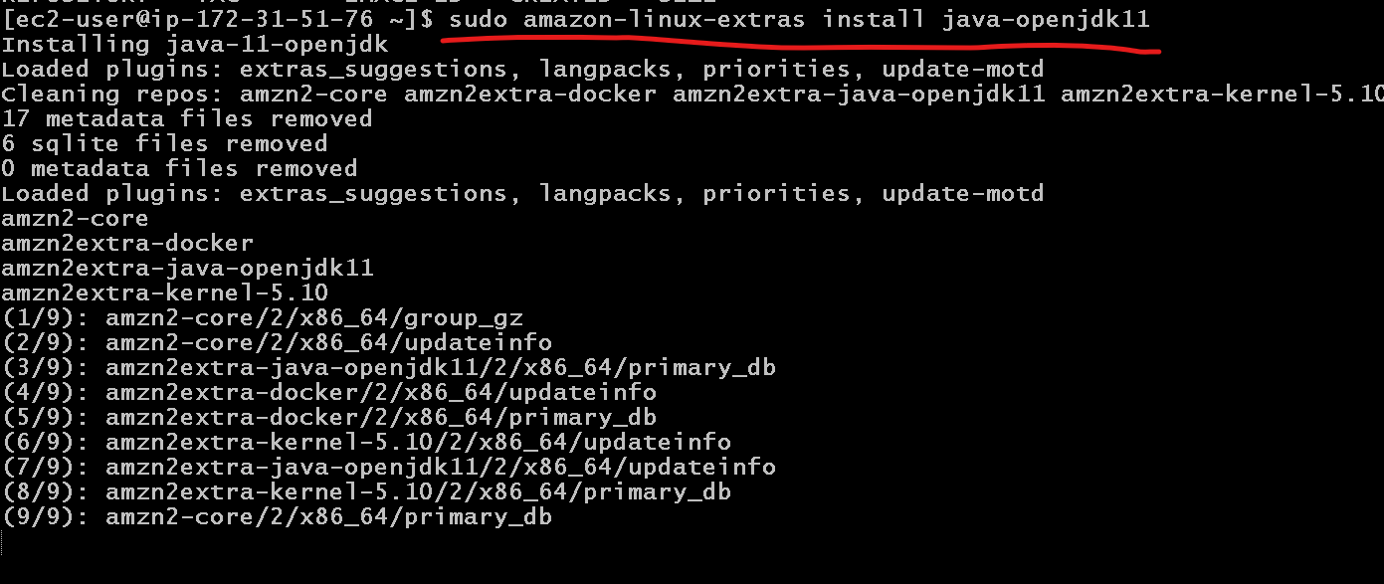

Slide 12
Now we will install jenkin
Pull jenkin software
sudo wget -O /etc/yum.repos.d/jenkins.repo https://pkg.jenkins.io/redhat/jenkins.repo
Extract that software
sudo rpm --import https://pkg.jenkins.io/redhat-stable/jenkins.io.key
Now install this software
sudo yum install jenkins (please enter y) if it ask.
Then we need to start the service
sudo service jenkins start
To check the service status
sudo systemctl status jenkins

Slide 13
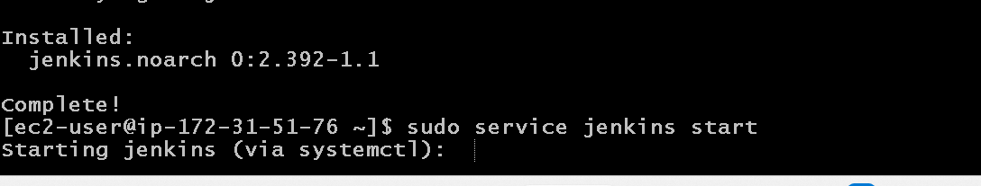
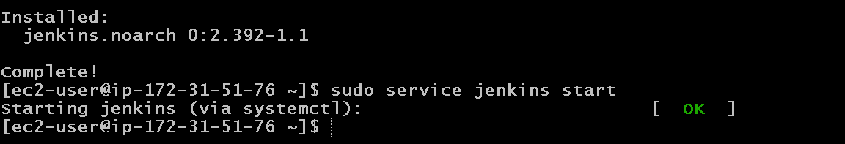
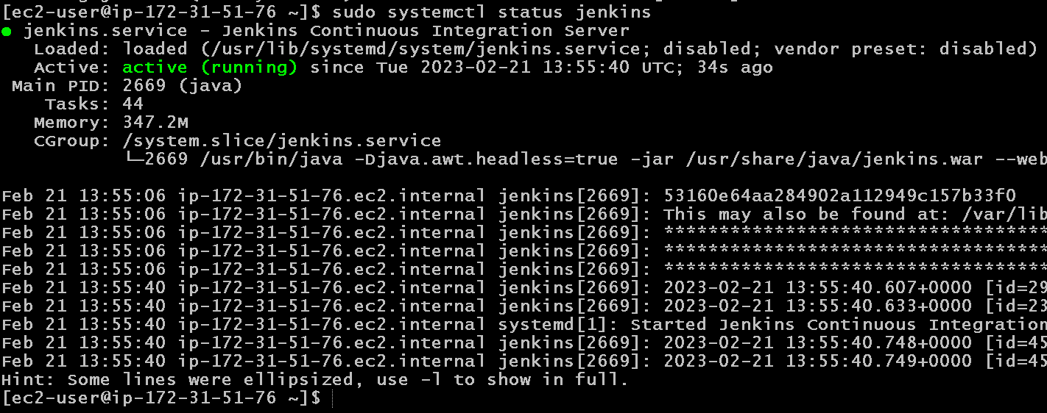

Slide 14
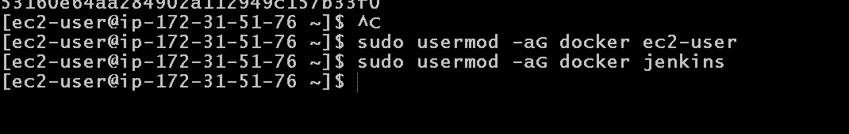
Now we will add usermod Jenkin and docker
sudo usermod -aG docker jenkins
sudo usermod -aG docker ec2-user

Slide 15
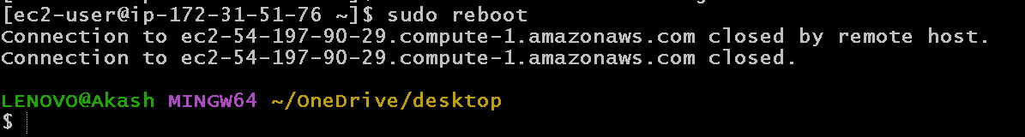
To get the effect please reboot ec2 instance
sudo reboot
After reboot please wait few minutes then reconnect

Slide 16
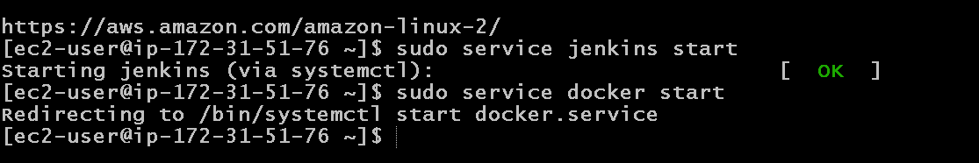
After re-connected to ec2 instane
We need to start Docker and Jenkin once again
sudo service docker start
sudo service jenkins start

Slide 17
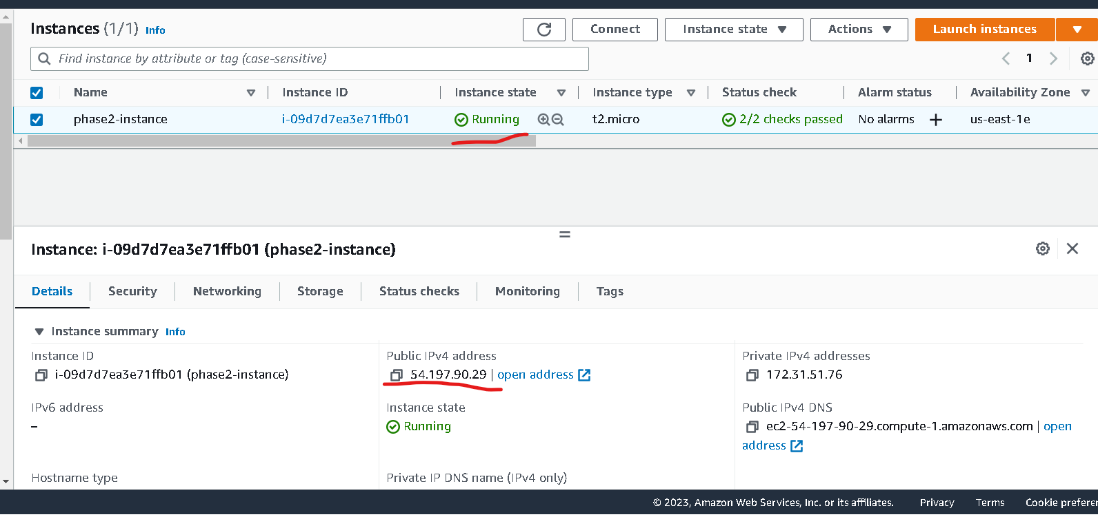
Check ec2-instance ip address

Slide 18
Application running on port number
Jenkin running on port number 8080 (default port number).
Nginx server running on port number 80( default port number).
So now we need to open both port number in inbound.

Slide 19
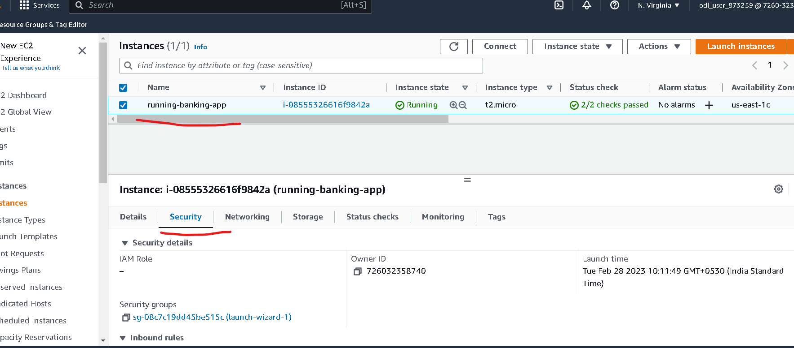
Select the security option

Slide 20
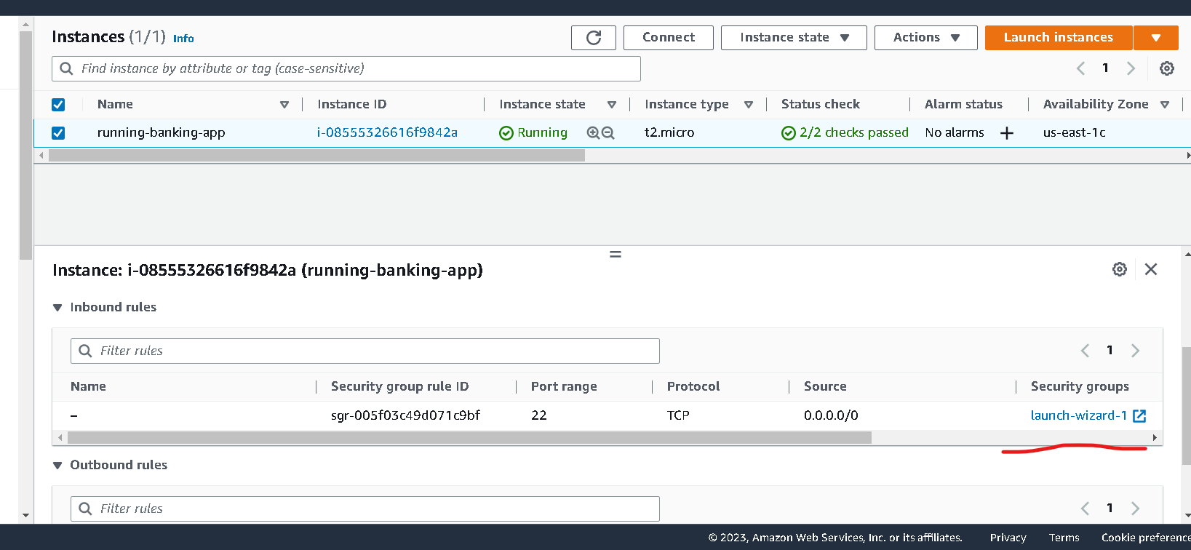
Search security launch wizard

Slide 21
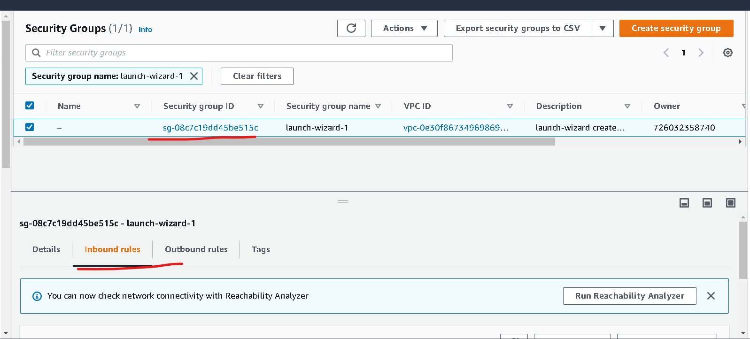
Once you click on launch wizard it open another tab in browser.

Slide 22
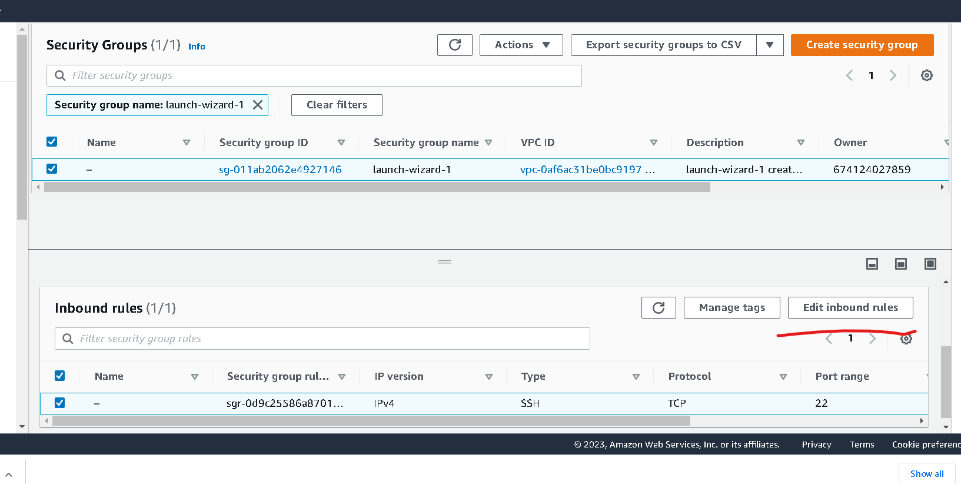
Search edit inbound rules

Slide 23
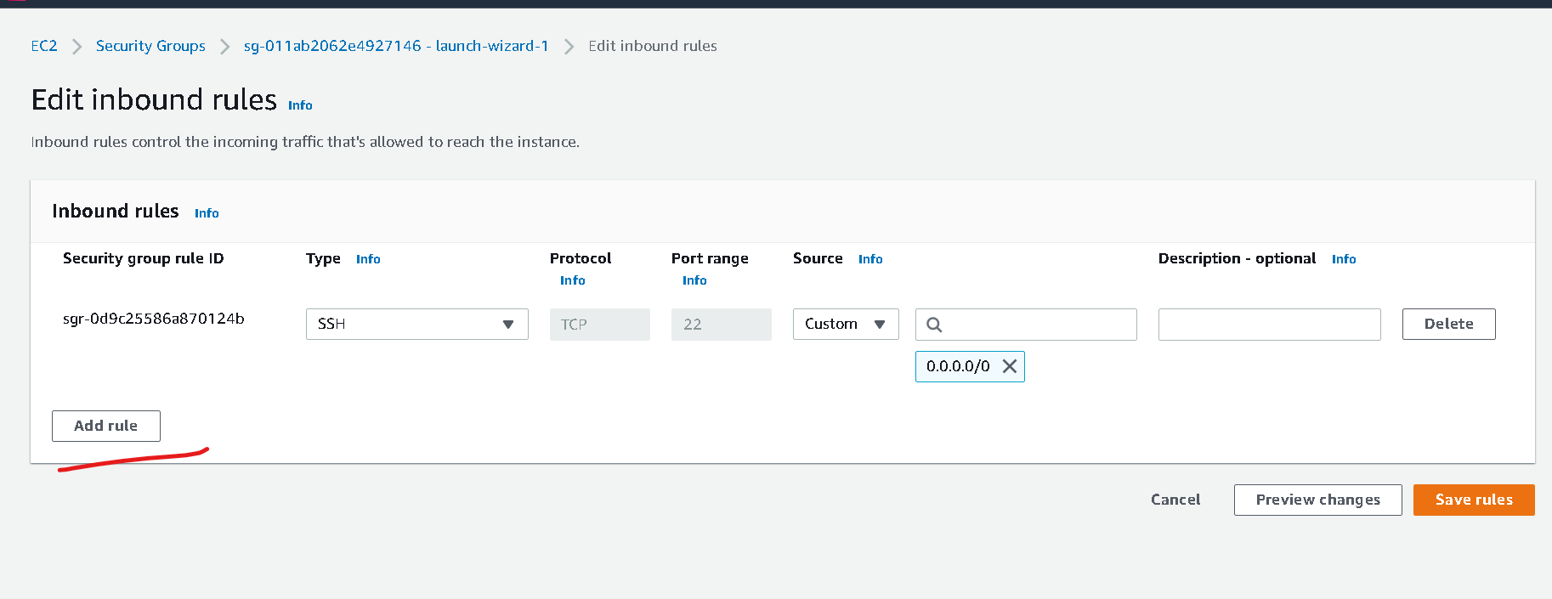

Slide 24
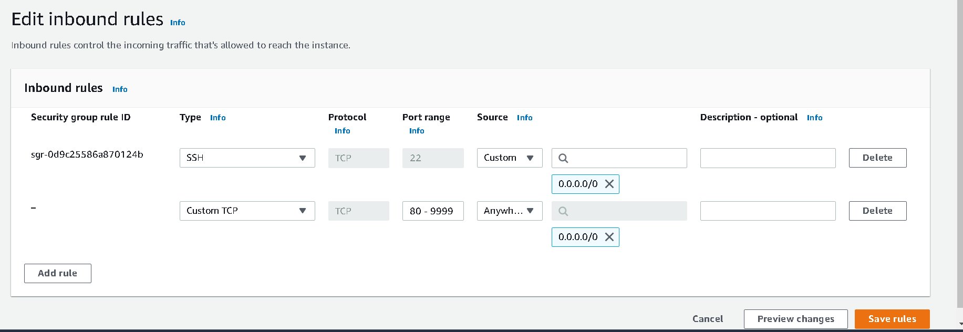
Click on add rule
Type must be : custom type
Protocol : TCP
Port range : 80-9999 ( means we can use any port number between range 80 to 9999)
Source : anywhere
Click on save rules

Slide 25
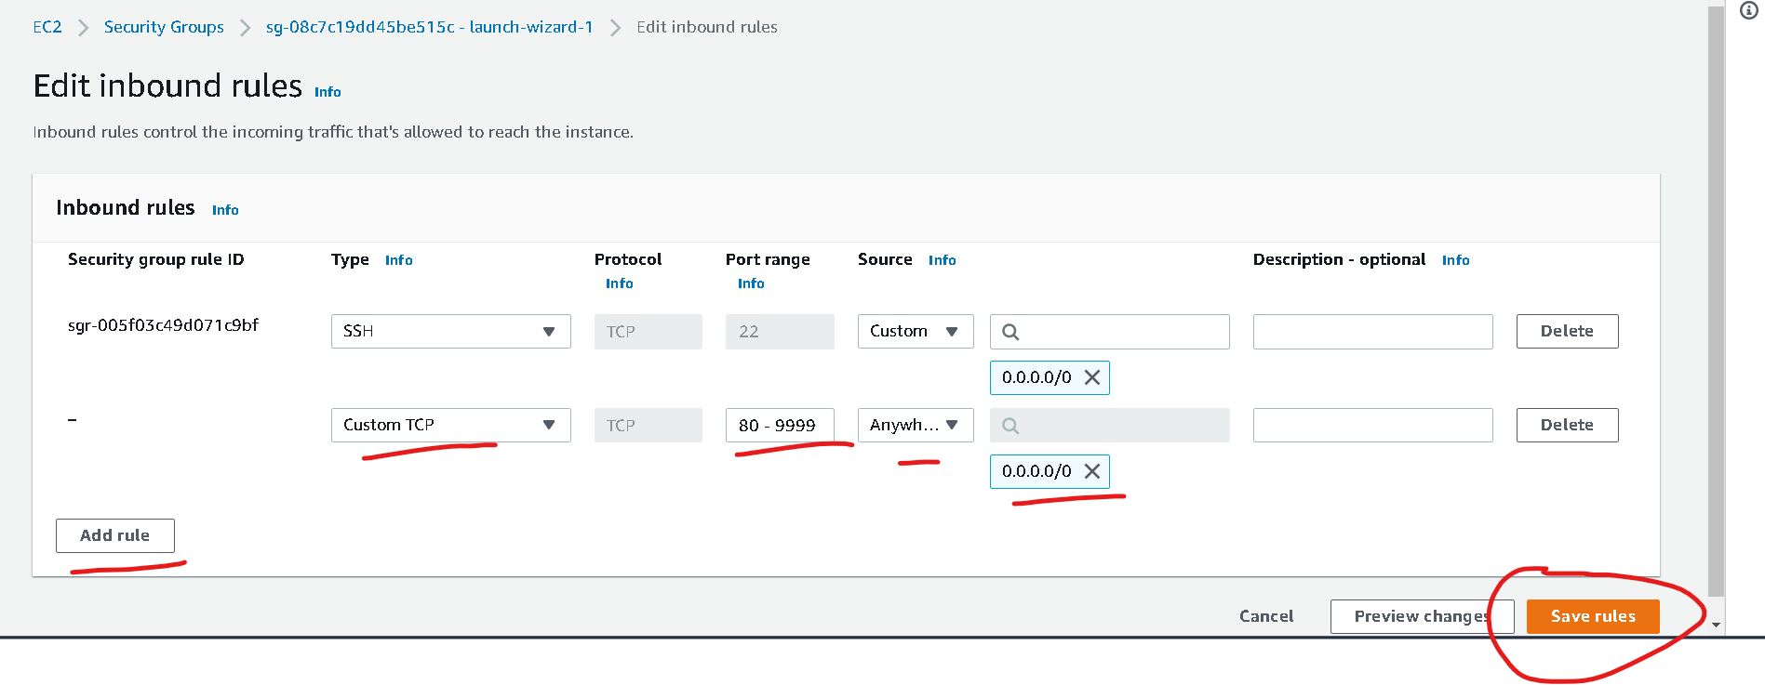
Check your ec2 instance ip address

Slide 26
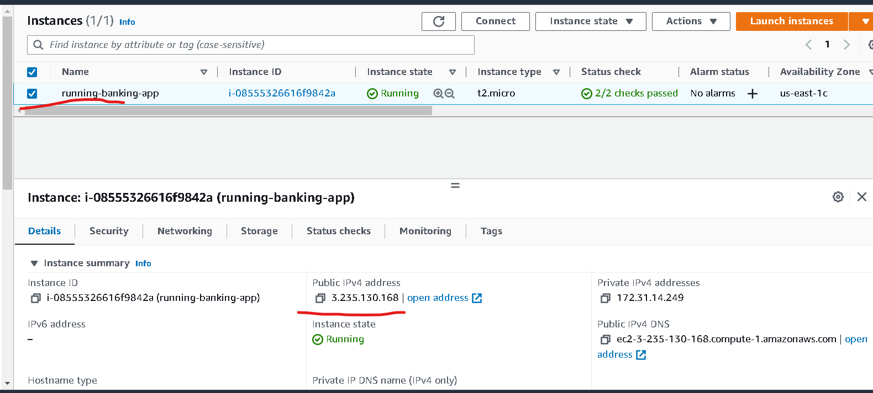
Instance details

